Slide 1

Capstone Project – Phase II Project Title : Real-Time Facial Expression Recognition using Deep Learning Team Details : Guided by : Dr. S. Oswalt Manoj
NAME | REGISTRATION
Ms. Pavana V Reddy | 2022BCSE07AED915
Ms. Yeduginjala Likhitha | 2022BCSE07AED826
Ms. Ankita Sonth | 2022BCSE07AED860
Ms. Nithya N | 2022LCSE07AED1040

Slide 2

Problem Statement
Facial expressions are one of the most powerful non-verbal cues used by humans to convey emotions, intentions, and reactions. Accurately recognizing these expressions enables machines to better understand human emotional states, leading to more natural and effective human–computer interaction. As a result, facial expression recognition has gained significant importance in applications such as healthcare monitoring, smart education systems, security surveillance, customer service analysis, and interactive technologies.

Slide 3
Existing System
Use of basic CNN-based architectures
Trained on static facial emotion datasets
Most existing systems recognize only a few basic emotions and often fail to accurately capture emotions like disgust and other subtle emotional variations.
Limited focus on real-time deployment
Model decisions are not interpretable

Slide 4
Proposed system
The proposed system performs real-time emotion detection using deep learning techniques integrated with explainable artificial intelligence for interpretability. The facial emotion dataset consists of images representing expressions such as happiness, sadness, anger, fear, surprise, disgust, and neutrality.
Preprocessing steps include image resizing, normalization, augmentation, tensor conversion, and pixel value scaling to ensure consistency across the dataset. The system employs multiple architectures, including Convolutional Neural Networks (CNN), Vision Transformers (ViT), a CNN–ViT hybrid, and the Xception model, to effectively capture spatial and contextual features from facial images.
Model evaluation is based on key performance metrics such as accuracy, precision, recall, and F1-score. For interpretability, Explainable AI (XAI) techniques—GradCAM, LIME, and SHAP—are applied to visualize important facial regions and explain model decisions.
The entire framework is deployed through a Flask-based interface that integrates OpenCV and dlib for real-time emotion recognition, ensuring efficient and transparent human-computer interaction.

Slide 5

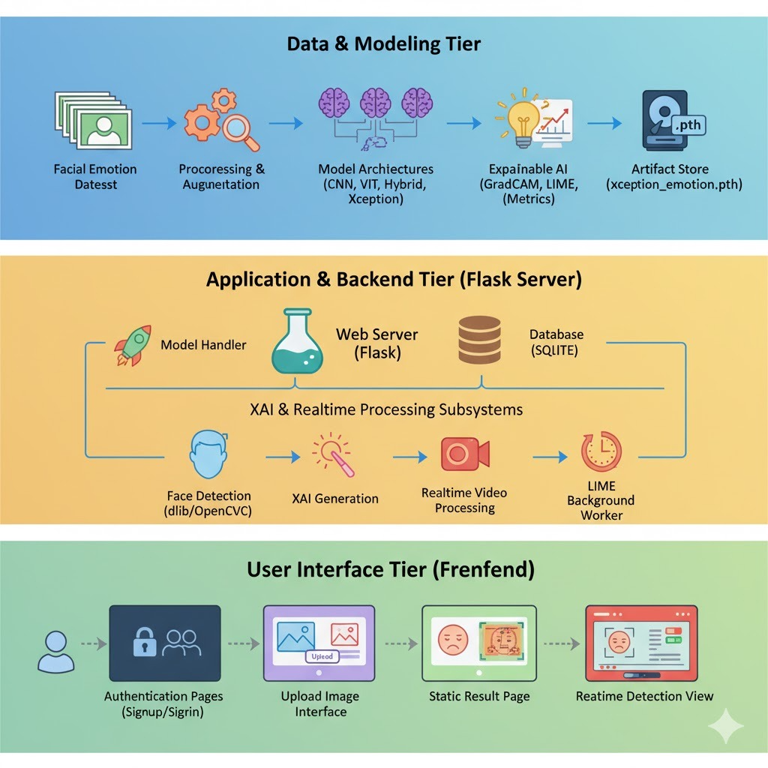
Architecture

Slide 6
Technology Stack
SOFTWARE REQUIREMENTS
HARDWARE REQUIREMENTS
Software: Anaconda (2023.03-1)
Primary Language: Python (3.10.9)
Web Framework: Flask
Development Environment: Jupyter Notebook
Database: Sqlite3
Front-End Technologies: HTML, CSS, JavaScript and Bootstrap4
Operating System: Windows 10 (Min) and Above
Processor: i5 9th Gen and Above
RAM: 8GB (Min) – 16 or 32 Preferable
Hard Disk: Free space 100 GB (Min)

Slide 7
Key Features
The system performs real-time emotion detection using facial expressions.
It uses a deep learning-based model for accurate emotion recognition.
The application has a web-based interface, making it easy for users to access.
It also includes secure user authentication for data protection.
Explainable AI is integrated to help understand model predictions.
The system provides real-time visualization of results and is designed with a scalable architecture for future expansion

Slide 8

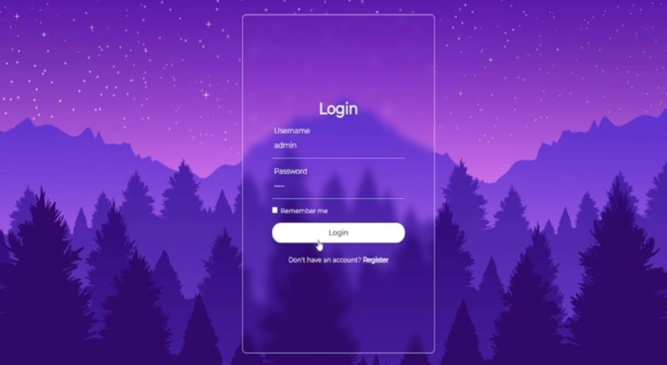
Demo Screenshots User Authentication Module :

Slide 9


Slide 10
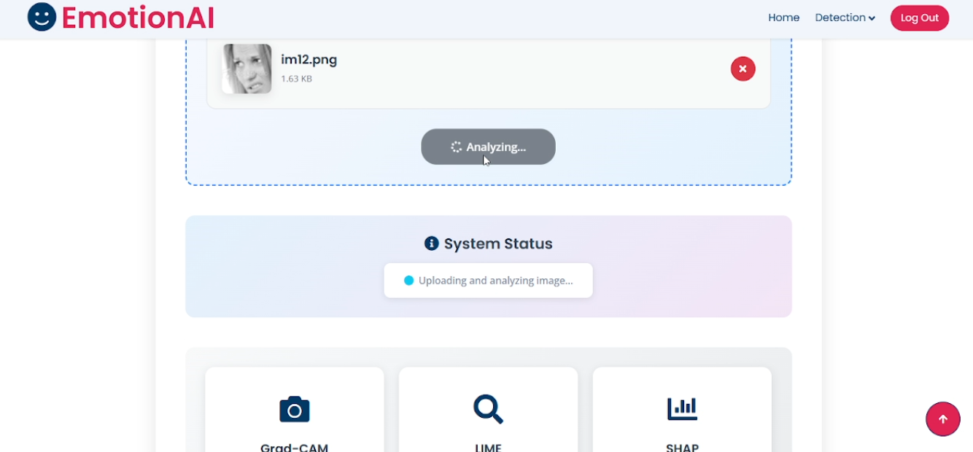
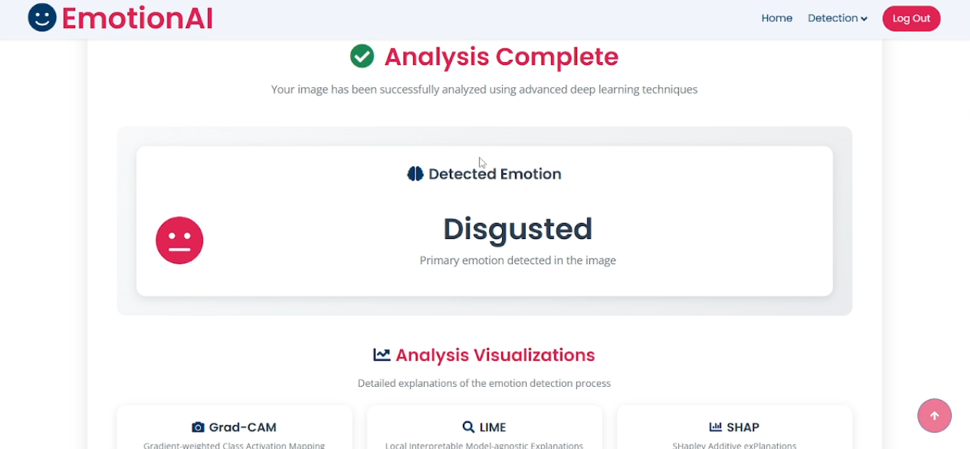
Results of Proposed work
Output screenshots

Slide 11

Quantitative Results
Metrics table
Model | Accuracy | Precision | Recall | F1 – score
CNN | 0.5442 | 0.5893 | 0.5061 | 0.5293
ViT | 0.6615 | 0.6169 | 0.6728 | 0.6333
CNN + ViT | 0.6663 | 0.6548 | 0.6452 | 0.6480
Xception | 0.6892 | 0.6981 | 0.6772 | 0.6833

Slide 12
Results-Graph
Performance graph :

Slide 13
Results
The developed system successfully detects human emotions in real time using a webcam feed.
Deep learning models such as CNN, Vision Transformer (ViT), CNN–ViT hybrid, and Xception effectively classify facial expressions including happiness, sadness, anger, fear, surprise, disgust, and neutral.
The implemented preprocessing techniques improved data consistency and model performance.
The system achieved reliable performance based on evaluation metrics such as accuracy, precision, recall, and F1-score.
Explainable AI techniques (Grad-CAM, LIME, and SHAP) successfully highlighted the important facial regions influencing emotion predictions, improving transparency and interpretability.
The Flask-based web interface integrated with OpenCV and dlib enabled smooth real-time emotion detection and user interaction.

Slide 14
Conclusion
Analyzed facial expression recognition methods and identified key limitations.
Designed a real-time deep learning–based emotion recognition system.
Selected models, set up the development environment, and implemented secure user authentication.
Prepared the system for integrating real-time detection, explainable AI, and visualization.
Future Scope
Improve model accuracy using larger and more diverse facial expression datasets.
Extend the system to detect multiple faces and emotions simultaneously.
Deploy the system as a mobile application for wider accessibility.
Integrate advanced Explainable AI techniques for better transparency of predictions.
Apply the system in real-world domains such as healthcare, online learning, security, and human–computer interaction.

Slide 15
Thank You

